Slide 1
Improved Wood Based Cremation System - Swarahantra
Swarahantra is from “ Swarg Rah Yantra” it means ‘A machine, takes Souls to Heaven ’.
This is a Eco-friendly way to Cremate a Dead Body with wood Consumption Approximately 25% (110 Kg). Which can fulfill the Need of Recent Problem associated with the Dead Body cremation in INDIA. In this all the Rituals [Agni Kastha, Mukhagni, Panch samidha, Kapal kriya,Asthi followed by Hinduism, Sikhism, Jainism etc. can be fulfilled.
It is Designed in such a way so that maximum heat evolve from the burning of wood is utilized for cremation of the dead body (i.e. Maximum Combustion Efficiency) and air input is as per requirement for complete combustion & controlled so that less Suspended Particles in Flue gas.
Swarahantra

Slide 2
Traditional Way to Cremate
Cremation in SWARAHANTRA
400 – 450 Kg of Wood is required to cremate a dead body.
This process done in open air (Environment).
This process Take Approximately 8 hours.
People reluctant to wait at cremation ground due to bad smell / odor.
Dead body is to be adjust during the cremation.
Animal try to reach half burnt body.
Lot of ash is left out after Cremation.
People Prefer just because of Traditions and Riti- Rivaj over Electrical cremation.
110 - 130 Kg of Wood is required to cremate a dead body.
This process done in Closed Chamber
This process Take Approximately 1.5 hours.
People can stay there to see the last journey of there dear one’s.
No adjust required during the cremation.
Out of reach from animal.
Very less ash is left out after Cremation. (15% as compared to traditional)
All the rituals can be perform in this as it is in tradition way.
Swarahantra

Slide 3
Top Three Ganga Pollution Sources
Municipal waste
Untreated industrial effluent
Traditional Cremation System
Challenges
of
Traditional Cremation Systems
Poor Combustion Efficiency
High Wood Consumption - 400 kg/Cremation
Incomplete Combustion Of Dead Body
Wet wood, Rain, Low Combustion Temperature, Inadequate Wood
Water Pollution
Air Pollution
Ashes from Cremation along with Partially burnt bodies are disposed off in the river causing hazardous WATER POLLUTION
Foul and untreated poisonous gases released from inefficient combustion causes hazardous AIR POLLUTION
Swarahantra

Slide 4
NEED OF HOUR
Swarahantra
Pollution Control & Wood Saving
Budget
Sentiments Of People
Swarahantra

Slide 5
Process to cremate in “ Swarahantra”
Pyre of wood (Agni kastha) is made on the cremation trolley.
The dead body is place upon the wood pyre, with leg pointing south.
One layer of wood is placed over the dead body.
All Rituals ( Riti - Rivaj ) are carried out on the trolley it self, viz.
Dead body should be anointed with the ghee and wood chips
Eyes, mouth ears and nostrils are covered with coins
One person carry a pot of water on the left shoulder, with another person walks behind him with a sharp iron Instrument. Both of them go around the pyre anti-clockwise three times. When the person carrying the pot reaches the head each time, he stops for a second or two, and the one with the iron instrument hits the pot Gently to make a hole so that water flows out from the hole.
The pyre is fired and there after the Fire rituals are performed, i.e. “Panch Samidha” giving five wood pieces by the close one to the burning pyre.
Swarahantra

Slide 6
After all the rituals, the cremation trolley is pushed inside the Cremation Furnace, for Cremation in controlled conditions.
This cremation process occur with air is feed in Control Condition for perfect Cremation of the dead body.
Cremation furnace gate is closed .
Whole process of cremation can be seen by view glass provided at the gate of the cremation furnace.
When the body is almost burned. A man open the door to perform the Kapal Kriya. In this ritual one man hits the head of dead body and pore the gee on head.
The gases leaving the cremation furnace is scrubbed in wet scrubber and vent it to the environment through a chimney.
After Completion of cremation the Ash (Asthiyan) for further ritual (Asthi puja) is collected from the Tray under the Trolley.
Swarahantra

Slide 7
Why This System Will Not Fail
As per mentality of people cremation is done on wood only.
All the Ritual can be proform as it is.
A important ritual “KAPAL KRIYA” can also be done by opening the front door.
A watch glass is provided at the door to see the cremation process in the furnace.
People are moving step ahead for non polluting cremation system if they don’t need to leave their rituals. As they too are concerned about our environment.
People can stay there till completion of cremation.
People may receive “Asthiya “ just after the cremation or after 24 hr (their choice)
No odor / smell or No risk of disease.
“ RESPECT RITUALS , SAVE ENVIRONMENT ”
Swarahantra

Slide 8
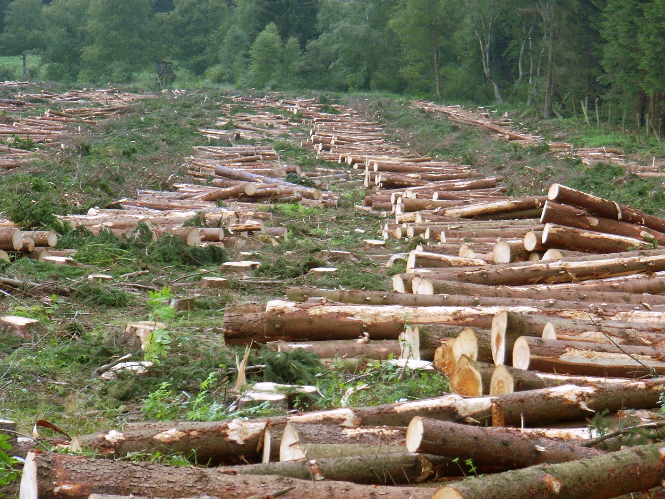
Saving Wood – Saving Trees – Saving Money
Approximately 2.5 Crore Trees can be save per year
2.016X10^6 Ton/year wood is saved = 1612.8 Crore Rs
will be saved @ 8 Rs /Kg

Slide 9
Reduction in GHG Emissions
Reduction in CO₂ @ of wood saved.
This system saves 300 Kg of Wood per Cremation.
Reduction in CO₂ 2.016X10^6 Ton X 1.6 = 3.23 M Tons/Annum
1.6 Kg / 1 Kg
Approximately 3.2 Million Tons /Annum
Swarahantra

Slide 10
Savings Per Crematorium
5 Cremations per Day
Wood saved per cremation = 300 Kg
Wood Saved = 300 X 365 X 5 = 5,47,500 Kg,
Cost of Wood = Rs. 8/Kg.
Rupees Saved = 5,47,500 x 8 = Rs. 43,80,000 / Year
Reduction in CO2 Emission = 5,47,500 X 1.6
= 876,600 Kg.
Swarahantra

Slide 11
Saving in Wood, Pollution, Time, Space, Ash
Approximately 300 Kg of Wood Is Saved Per Cremation.
More than 95 % Pollution can be Controlled.
Time Required max. 2 hour against 8 hours in Traditional way
Space Needed is Less.
Ash Formed Is Much less as compared to Traditional way. (Reduction Approximately 85 %)
Swarahantra

Slide 12
Salient Features
Significant reduction in Deforestation
Significant reduction in Air Pollution
Significant reduction in Global Warming
Prevent Acid Rain
CDM Benefits
Reduce deforestation will reduce soil erosion and landslide etc.
Reduce water pollution as after cremated Ash is less in quantity.
Keep environment Neat , Clean , hygienic & healthy.
Pay Back period is less than 1 year, by wood saving and CDM benefits
Swarahantra

Slide 13
For all related queries of the project
“Swarahantra –
Improved Wood Based Cremation System”
may communicate us :
V. P. Maurya ,Director, Technical: +91-9454485649 ,+91-7607602764.
DHRUVH -Social Awareness Forum
2nd Floor, ShreeDeep Apartment, 146, Naya Basti Road, New Delhi -110062, India.
Phone : +91-9873343383, +91-9968697193. E-mail: projectlastrite@gmail.com, URL:www.dhruvh.org.in

